Slide 1

StreamHub – Full-Stack Video Streaming Platform
Submitted by
Candidate Name: Neha Kaneriya
Enrolment. No.: 25034211020
Candidate Name: Vidhi Kansagara
Enrolment. No.: 25034211021
Submitted to MCA Department
A M Patel Institute of Computer Studies

Slide 2
1.1 Project Profile
Project Profile | Details
Project Title | StreamHub – Full-Stack Video Streaming Platform
Project Type | Web-Based Full-Stack Application
Objective | To develop a customizable, secure, and full-stack video streaming platform with adaptive HLS streaming, user authentication, role-based access, and administrative management.
Group No. | 04
Technology Stack | React.js, TypeScript, Vite, Tailwind CSS | Java, Spring Boot, Spring Security, Spring Data JPA, Redis
Database & Streaming | MySQL, Redis | HTTP Live Streaming (HLS) – Adaptive Bitrate Streaming
Authentication & API | JWT-Based Authentication with OAuth2 Login Support | Swagger / OpenAPI
Tools & IDE | IntelliJ IDEA, VS Code, Postman, Maven, Git & GitHub, FFmpeg
Operating System | Windows 11
Project Duration | MCA Semester III (2025–2027)
Project Guide | Dr. Aruna Gurjar
Coordinator / Principal | Dr. C. D. Patel | Dr. Nirbhay Chaubey
Submitted By | Neha V. Kaneriya & Vidhi K. Kansagara

Slide 3
1.2 About Organization
About College
Acharya Moti bhai Patel Institute of Computer Studies (AMPICS) is a reputed institute specializing in Computer Applications and Information Technology. It focuses on quality education, technical skills, innovation, and industry-oriented learning.
About University
Ganpat University (GUNI) is a multidisciplinary university in Gujarat offering programs across various fields. It focuses on education, research, innovation, and skill development. AMPICS is a constituent institute of Ganpat University.
About Program
The Master of Computer Applications (MCA) is a postgraduate program focused on software development, programming, database management, web technologies, and modern computing practices.

Slide 4
2.1 Problem Statement
Raw video storage and direct playback can cause slow loading, buffering, and poor streaming performance.
Without role-based access control, separating user and administrator responsibilities becomes difficult.
Basic hosting solutions may lack secure authentication and proper user management.
Managing video uploads, users, feedback, and administrative activities can become complex and unorganized.
Video management can become complex and unorganized; StreamHub improves this through centralized management of users, videos, and feedback.

Slide 5
2.2 Existing System
Existing video-streaming solutions were studied, including:
ClipBucket : open-source video-sharing environment
PeerTube : self-hosted and federated video streaming
Datarhei Restreamer: on video streaming and stream management
These platforms provide useful streaming capabilities, but their architectures and workflows are designed for their own specific purposes.

Slide 6
2.2.1 Drawbacks
Aspect | ClipBucket | PeerTube | Datarhei Restreamer | StreamHub
Video Streaming | Yes | Yes | Yes | Yes
Role-Based Access | Yes | Yes | No | Yes
Google OAuth2 Login | No | No | No | Yes
Refresh-Token Rotation | No | No | No | Yes
OTP Email Verification | No | Yes | No | Yes
User Comments | Yes | Yes | No | Yes
Platform Feedback Module | No | No | No | Yes
Custom Admin Workflow | No | No | No | Yes

Slide 7
2.3 Proposed Systems
StreamHub is a customized full-stack video streaming platform designed to provide greater control over the application's features, workflows, and architecture.
Adaptive Video Streaming — FFmpeg-based HLS processing
Secure Authentication — JWT, refresh-token rotation & Google OAuth2
User & Admin Management — Separate roles and controlled access
Video Management — Upload, stream and manage videos
Admin Dashboard — Users, videos and feedback management
Custom Full-Stack Architecture — React.js + Spring Boot + MySQL
Email Verification — OTP-based verification using SMTP with Redis TTL and secure OTP expiration
Search & Pagination — Efficient video search and paginated content browsing

Slide 8
2.3.1 Comparison Study
Feature | ClipBucket | PeerTube | Datarhei Restreamer | StreamHub
Video Upload & Streaming | Available | Available | Streaming-focused | Available
Adaptive HLS Streaming | Available | Available | Available | HLS + FFmpeg
Role-Based Access | Available | Admin / Moderator / User | Admin-focused | User / Admin
Authentication | Login / Registration | Access Token / OAuth2 | Login / JWT | JWT + Google OAuth2
Video Management | Upload & Manage | Upload & Manage | Stream Management | Upload + My Videos
Comments | Available | Available | Not a core feature | Comments + Moderation
Email Verification | Not highlighted | Available | Not a core feature | OTP + Redis TTL
Feedback Module | Not a core feature | Not a core feature | Not a core feature | Built-in Feedback

Slide 9
2.3.2 Modules
USER AUTHENTICATION
Registration, JWT, refresh tokens & Google OAuth2
ADMIN AUTHENTICATION
Dedicated admin login & ROLE_ADMIN authorization
1
2
USER MANAGEMENT
Profile management & administrator account control
4
VIDEO UPLOAD & STREAMING
FFmpeg + HLS adaptive streaming + HTTP Range
3
MY VIDEOS
Personalized uploaded videos with manage/delete options
ADMIN DASHBOARD
Platform statistics, users, roles & video management
5
6
7
COMMENT
Users can comment and admins can moderate discussions.
8
Email Verification
6-digit OTP verification with secure expiry and resend control.

Slide 10
3.1 Hardware Requirements
1
PROCESSOR
Intel Core i5 (10th Gen) or higher AMD Ryzen 5 or higher
2
RAM
8 GB minimum 16 GB recommended for video processing
STORAGE
256 GB SSD or higher Additional storage for videos & HLS segments
DISPLAY
1366 × 768 resolution or higher
3
4
INTERNET CONNECTION
IBroadband connection Minimum 5 Mbps for streaming & API testing
6
OTHER
Keyboard, Mouse Stable power supply
5
Recommended: 16 GB RAM and sufficient storage for smoother video processing and HLS generation.

Slide 11
3.2 Software Requirements
Software environment and technology stack used to develop StreamHub
DEVELOPMENT ENVIRONMENT
Windows 10 / 11 • Visual Studio Code • IntelliJ IDEA • Java JDK 21
FRONT-END
React.js • TypeScript • JavaScript • Vite • Tailwind CSS Zustand • Axios • Video.js • React Router DOM
BACK-END
Spring Boot 3.5.7 • Spring Web • Spring Security Spring Data JPA • Spring Validation • OAuth2 Client
DATA & VIDEO
MySQL • FFmpeg Video processing and HLS conversion
SECURITY & API
JJWT • Spring Security • Google OAuth2 Swagger / OpenAPI (springdoc-openapi)
DEVELOPMENT & TESTING
ModelMapper • Git & GitHub • Postman • Maven • npm / Vite

Slide 12
3.3 Programming Environment
FRONT-END
React.js • TypeScript
Vite • Tailwind CSS
User Interface & Client-side Logic
BACK-END
Java • Spring Boot
Spring Security • Spring Data JPA
Business Logic & Server-side Processing
RESTful APIs
HTTP Request / Response
Front-End ↔ Back-End
DATABASE
MySQL
Persistent application data

Slide 13
3.3.1 About Front-End
REACT.JS + TYPESCRIPT
Component-based • Type-safe • Maintainable Front-End Architecture
VITE
Fast development server, bundling & Hot Module Replacement
TAILWIND CSS
Utility-first styling for a clean, responsive dark-themed interface
ZUSTAND
Lightweight state management for user & admin authentication
VIDEO.JS
HTML5 video playback with adaptive HLS streaming
AXIOS + REACT ROUTER DOM
Axios → REST API communication • Router DOM → client-side navigation

Slide 14
3.3.2 About Back-End
JAVA (JDK 21) + SPRING BOOT 3.5.7
Layered, secure and API-driven back-end architecture
LAYERED ARCHITECTURE
Controllers → Services Repositories DTOs • Entities
Separation of responsibilities
SECURITY & AUTHENTICATION
Spring Security + JWT Refresh-token rotation Google OAuth2
Secure stateless authentication
VIDEO PROCESSING
FFmpeg → HLS .m3u8 master playlist .ts video segments
Adaptive streaming preparation
REST API & DATABASE
Spring Web → REST APIs Spring Data JPA → MySQL
API exposure and entity-based database operations
SUPPORTING TOOLS
ModelMapper • Lombok Springdoc-OpenAPI / Swagger
Mapping • Boilerplate reduction • API docs

Slide 15
4.1 Time Line Chart

Slide 16
4.2 Data Dictionary

Slide 17
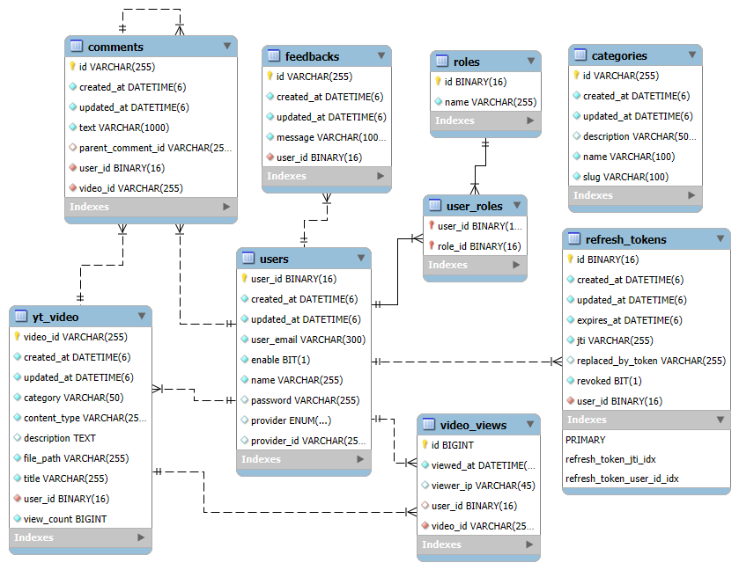
4.3 ER Diagram

Slide 18
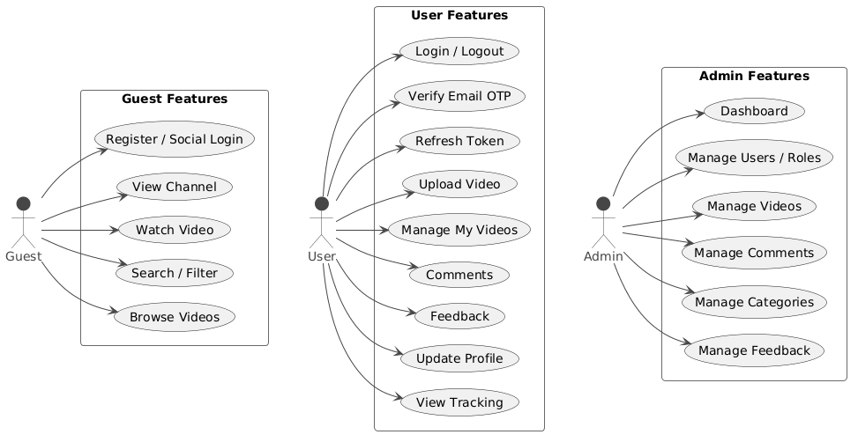
4.4.1 Use Case Diagrams

Slide 19
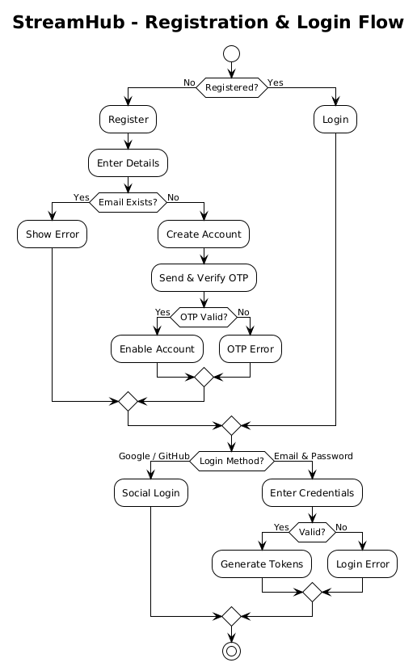
4.4.3 Sequence Diagrams

Slide 20
4.4.4 Collaboration Diagrams

Slide 21
4.4.5 Class Diagrams

Slide 22
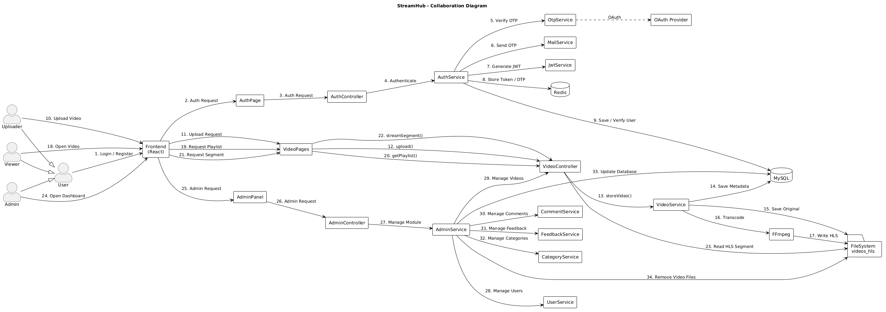
4.5 Input Design

Slide 23
4.6 Output Design

Slide 24
5.1 System Testing

Slide 25
6. Conclusion and Future Enhacement

Slide 26
7. Bibliography and References

